Slide 1
FICO Summer Youth Intensive Program
Guiding FICO Youth to
Succeed FICO’s Profession
Onsite Coaching a Week Internship
July 2021

Slide 2
FICO Model Builder Introduction

Slide 3
Table of Contents
Section 1 | Key capabilities and value of Model Builder
Section 2 | FICO scorecard technology
Section 3 | Modeling Techniques in Model Builder 7
Section 4 | Introduction to Model Builder Scripting
Section 5 | Introduction to Scoring
Section 6 | Creating a Scorecard Model
Section 7 | Variable Binning – Fine Binning
Section 8 | Variable Binning – Coarse Binning
Section 9 | Building Scorecard

Slide 4
Section 1 Key capabilities and value of Model Builder
Product Education
FICO

Slide 5

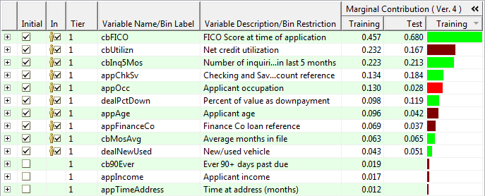
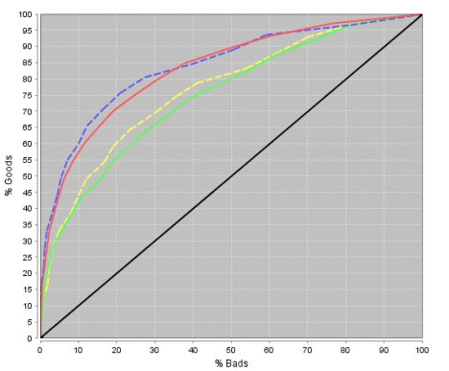
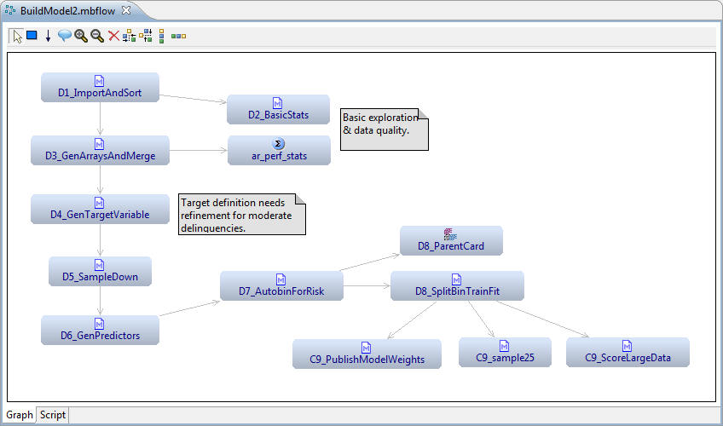
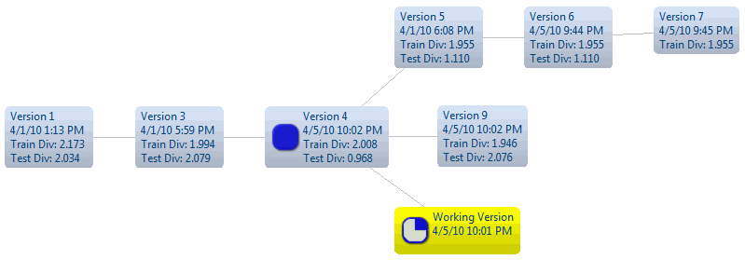
Model Builder Overview
Value Statement
Build & deploy better predictive models in less time with FICO Model Builder
Extract business insights from your Big Data assets—including very large and unstructured data
Use industry-leading FICO scorecard technology that combines analytic science and business expertise
Predictive model: An analytic model that estimates future behaviors of entities (accounts, customers, transactions, etc.), based only on facts known at the time of scoring.
Scorecard: A simple but powerful predictive model wherein data variables are binned into categories, each category carries a point value, and final scores are calculated by summing the points. Such scores can directly estimate or rank-order future outcomes such as an expected collection amount or the relative likelihood of delinquency or fraud.
Notes:
Model Builder is FICO’s predictive modeling platform, and leverages decades of FICO expertise to provide analysts with our industry creating Scorecard Technology, intuitive GUIs, and automation algorithms for many common, and historically labor intensive tasks.
Value Statement
Target users

Slide 6
Example Partial FICO® Scorecard
Characteristic | Attributes | Points
Number of bank card trade lines | 0 | 15
 | 1 | 22
 | 2 | 30
 | 3 | 40
 | 4 or more | 30
Number of trade lines with balance >0 | 0–1 | 65
 | 2 | 55
 | 3–4 | 50
 | 5–7 | 40
 | 8+ | 30
Number of months in file | Below 12 | 12
 | 12 to 23 | 35
 | 24 to 47 | 60
 | 48 or more | 75
Number of months since most recent bankcard opening | 0 to 5 | 20
 | 6 to 11 | 25
 | 12 to 17 | 30
 | 18 to 23 | 38
 | 24 or more | 45
Number of months since most recent derogatory public record | No Derog Public Record | 75
 | 0 to 5 | 10
 | 6 to 11 | 15
 | 12 to 23 | 25
 | 24 or more | 45

Slide 7
FICO® Scores Are Designed to Rank Order Risk
“Odds quote” based on the general population— not necessarily applicable to any one lender.
Specific lender's applicants will still “rank order”.
680
660
640
620

Slide 8
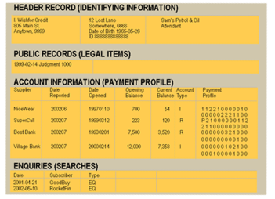
FICO® Score Development Data
Scoring date
Performance date
12 Months
Predictive Variable Snapshot
Target Variable Snapshot

Slide 9
Section 2 FICO Scorecard Technology
Product Education
FICO

Slide 10
Section 2: FICO Scorecard Technology
FICO’s Scorecards
Applications
Strengths

Slide 11
FICO Scorecard Technology
FICO’s Scorecards
Scorecards are FICO's proprietary predictive modeling technique. Scorecards are unique in their ability to account for business rules, legal and operational constraints, and biased or missing data, thereby generating scores that are not only highly predictive, but are also very interpretable and palatable to the business user.
Scorecards achieve these benefits through their flexible score formula that is based on Generalized Additive Models and augmentable with crosses between variables, and by employing non-linear constrained programming techniques to optimize score weights. The technology handles multiple objectives and constraints. These features have not been (and in some cases cannot be) implemented in other modeling techniques

Slide 12
FICO Scorecard Technology
Applications
Scorecards have been successfully applied to all fields of predictive modeling served by FICO. Examples of applications include web log transaction, fraud detection, credit customer retention, insurance dollar loss reduction, direct mailing response maximization and mortgage risk assessment. This modeling technology is commercially available in the Scorecard Module of FICO® Model Builder.

Slide 13
FICO Scorecard Technology
Strengths
Contains training algorithms that make no data structural assumptions other than that certain conditional score distributions are approximately normal.
Contains training algorithm for Maximum Likelihood Estimation (for producing Engineered Logistic Regression scorecards) and for boosting classification performance of a score.
Contains training algorithm that allows for two dependent variables, which enables, for example, developing a risk-adjusted response score.
Supports score development for binary as well as ordinal/continuous dependent variables.
Allows for constraints to be applied to score coefficient relationships (also called score weights restrictions or "score engineering") which provide for model stability and palatability.

Slide 14
FICO Scorecard Technology
Strengths
Provides properties of ridge regression via a weights penalty parameter, which can improve the performance on new data, especially for small samples.
Offers Bootstrap unbiased estimation of validation performance, which is useful if development sample is too small to set aside a representative test sample.
Allows for "Bagging" (Bootstrap Aggregation) of scorecards, a process in which many bootstrap replicas of a scorecard are fitted and then averaged.
Allow problem variables to be de-emphasized by range restriction for a given set of variables while trading off overall model strength.
Handles mixed variables (i.e., which take on continuous and categorical values).
Handles missing values (i.e., no information) without having to drop the observation. Missing values are forced to take on the neutral predictive score weight.
Provides automated and/or interactive fine and coarse binning of predictors, as required for developing Generalized Additive Models.

Slide 15
FICO Scorecard Technology
Strengths
Supports specification, engineering, and fitting of crossed binned predictors, which allows for interpretable interaction capture.
Allows for automated step-wise variable selection based on predictive power and business rules.
Allows for calculation of marginal weights for candidate variables not in the scorecard, providing insight into sources of potential model weakness.
Accommodates alternative performance inference capabilities.
Provides log odds to score fitting and score scaling options.
Score being approximately linear in log(odds) allows for multiple models to be aligned across segments of the population such that a score from any one of several models has the same interpretation.

Slide 16
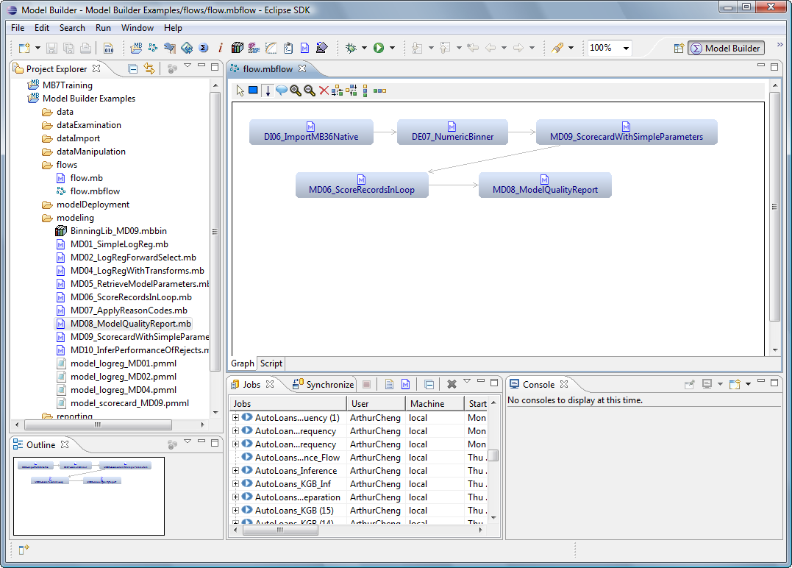
Model Builder 7 Overview
Model Builder 7 – FICO’s next generation predictive modeling platform.
A complete suite of tools for designing, developing, managing and deploying predictive models
Eclipse-based
Scripting-enabled
Rich set of features
Highly interactive &
integrated modeling
environment

Slide 17
Model Builder Integrated Modeling Environment
Model Builder 7 consists of plug-ins to the Eclipse software development platform
Provides a rich set of integrated tools
Project navigation
Data import/export, exploration, analysis
Work flow management
Code editing
Debugging
Model training
Reject Inference
Logging
Reporting

Slide 18
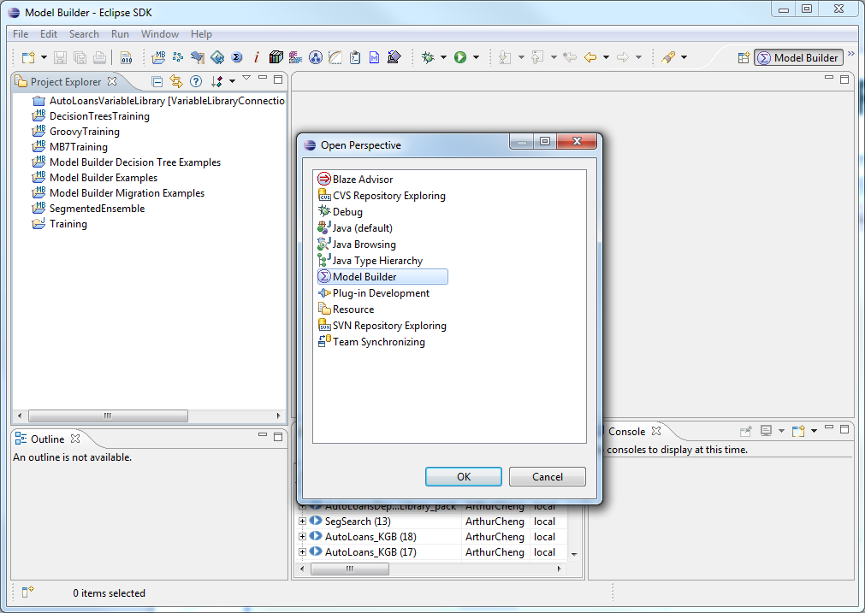
Eclipse Workbench and the Model Builder Perspective
A Model Builder perspective in Eclipse dedicated to building predictive models

Slide 19
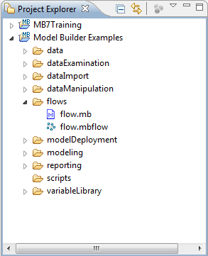
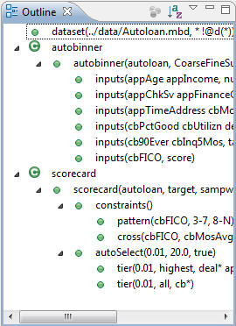
The Model Builder Perspective, Editors, and Views
In Eclipse, a perspective defines the initial set and layout of views and editors in the Workbench window.
Views support editors and provide alternative presentations as well as ways to navigate the information in your Workbench.
Project Explorer
Outline
Script editor
Flow editor
Data browser
…

Slide 20
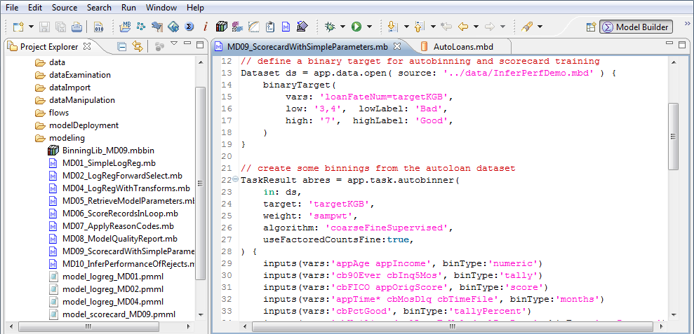
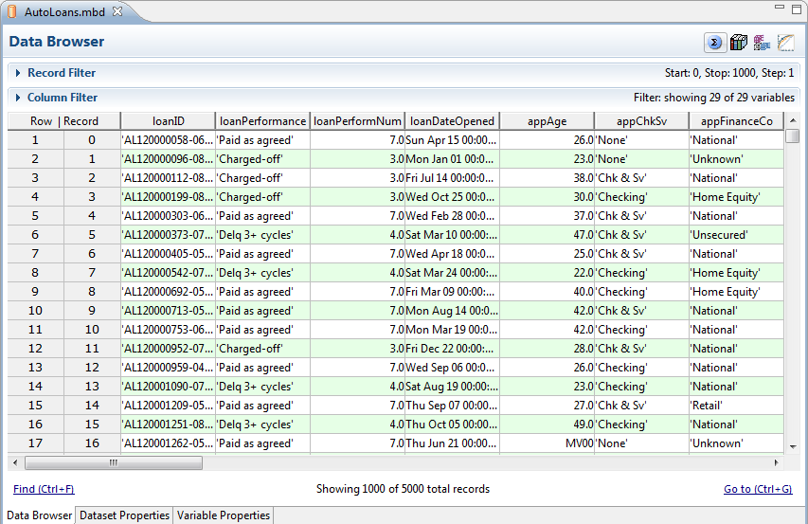
The Model Builder Perspective, Editors, and Views

Slide 21
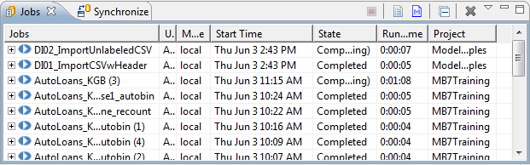
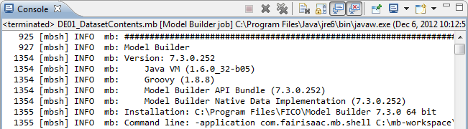
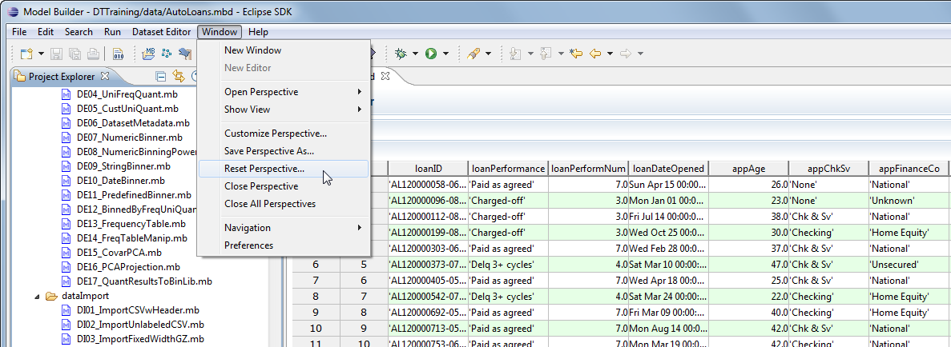
The Model Builder Perspective and Views
Reset current perspective to its defaults

Slide 22
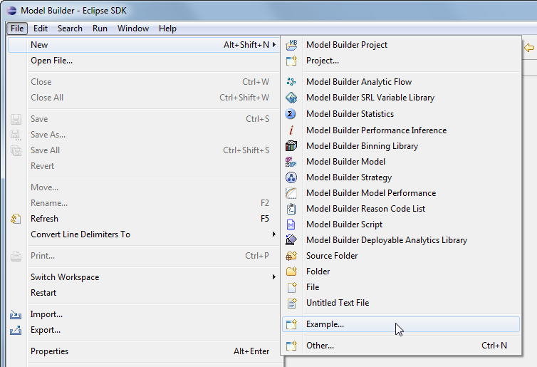
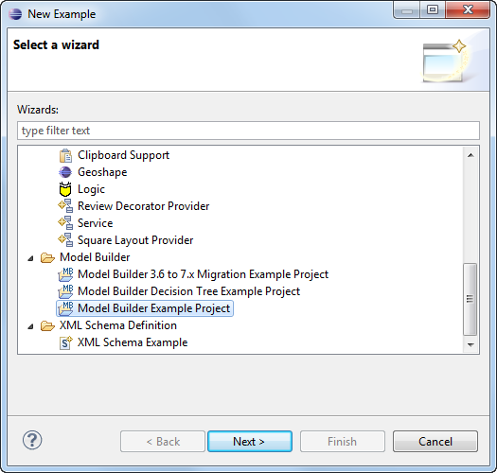
Model Builder Example Projects
Model Builder 7 has example projects within its installation
The example projects contain sample datasets and script examples for various tasks

Slide 23
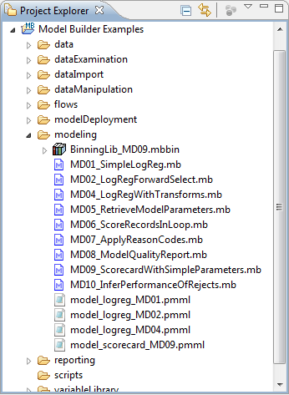
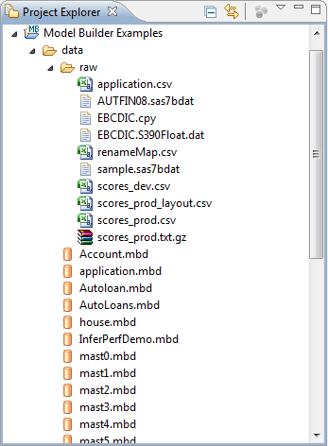
Model Builder Example Projects

Slide 24
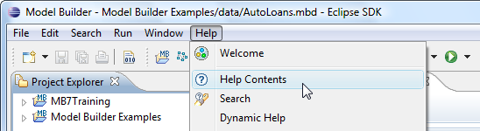
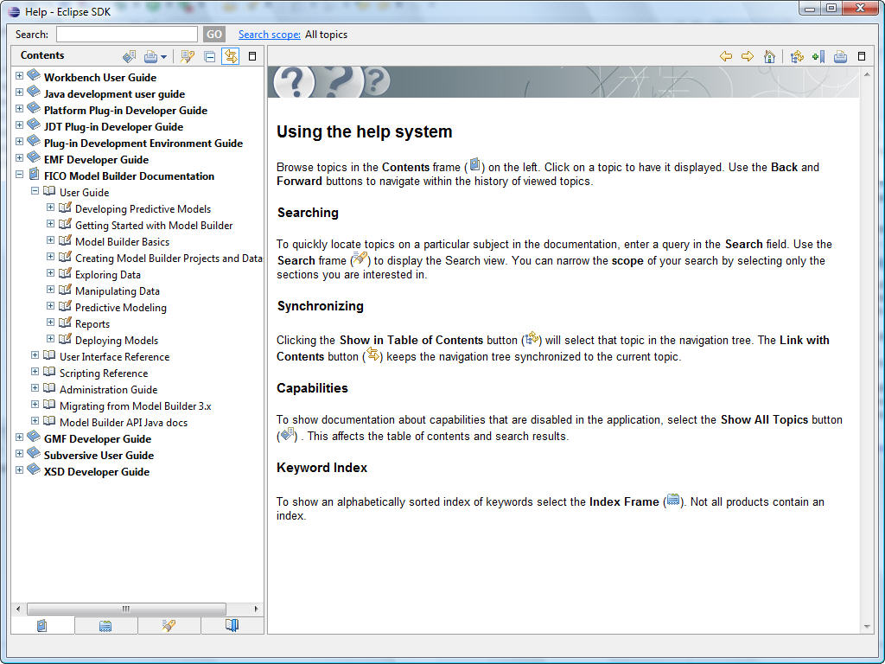
Model Builder Help System
Model Builder 7 has sophisticated product documentation

Slide 25
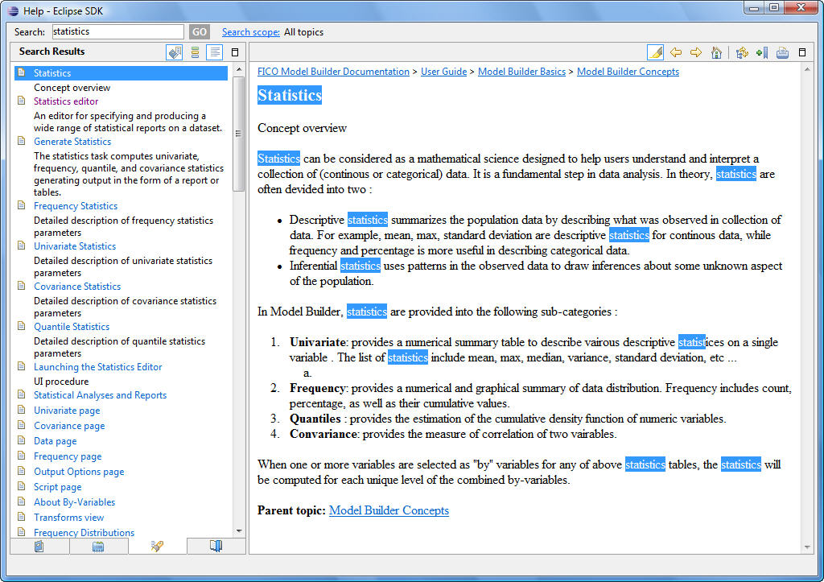
Search Through the Help System
The Help System supports keyword search

Slide 26
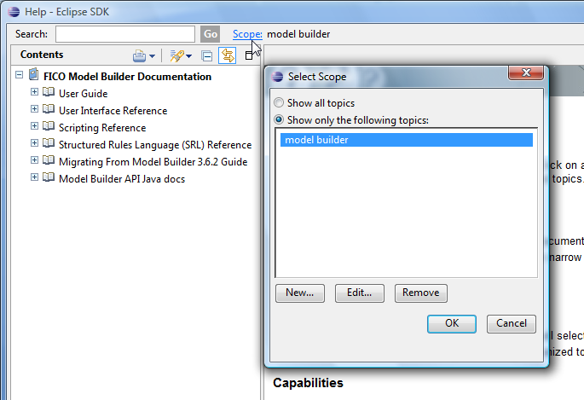
Define Search Scope
User can define search scope

Slide 27
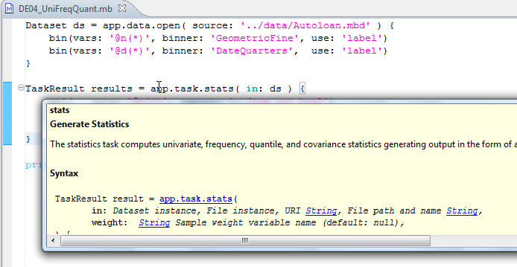
Interactive Help System
When writing scripts, hover the mouse over script keywords to access the Interactive Help System (Available for routines in app.task.* package)
Hit F2 to keep the dialog
Click on the links to access documentation

Slide 28
Section 1.b Project Management
At the end of this section, you will learn to:
Start Model Builder
Create a new project
Copy an existing project
Organize project workspace

Slide 29
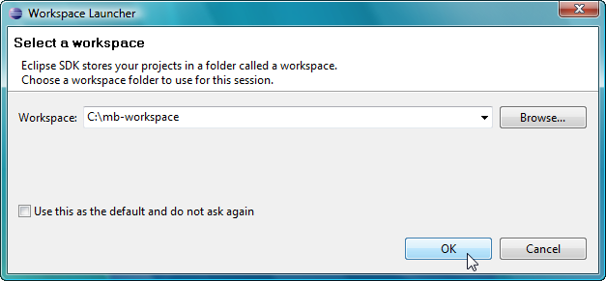
Managing Project Workspaces and Files
When Eclipse is first started, it prompts user to specify the location of a workspace
A workspace is a folder on the file system, and contains a number of projects
User can have multiple workspaces
All resources are organized into projects
A project is a collection of related project items and resources
A project has its own folder in a workspace

Slide 30
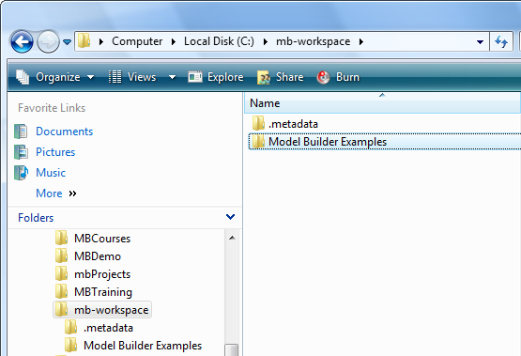
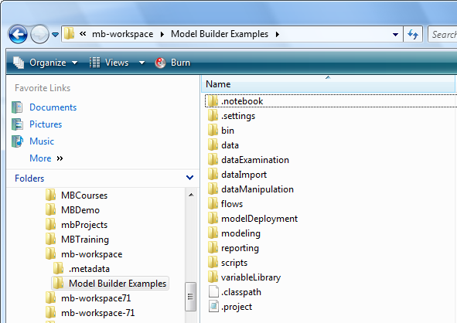
Workspace and Project Folders

Slide 31
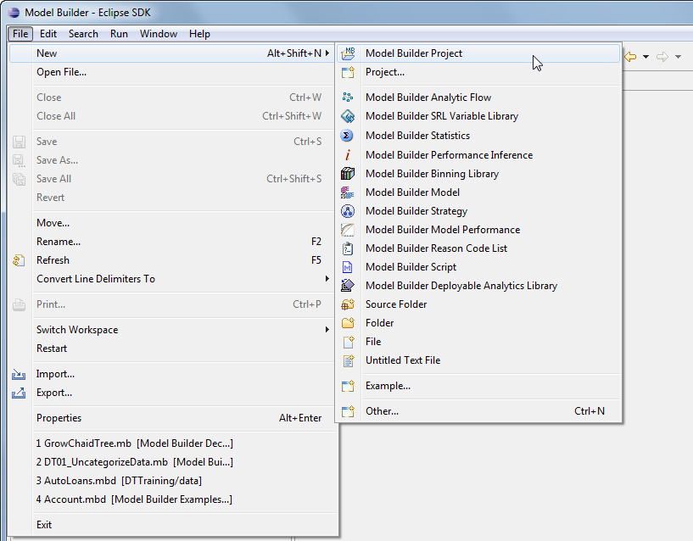
Creating a New Model Builder 7 Project
Use the Model Builder Project wizard to create a new Model Builder Project.

Slide 32
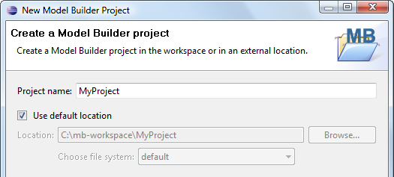
Create a New Model Builder 7 Project
Specify the name of the new project
Specify the location of the new project
Use the default location: by default, Eclipse creates a folder with the same project name in the current workspace
Use an alternative custom location
There is option to use a remote file system
Always create a project inside a workspace!

Slide 33
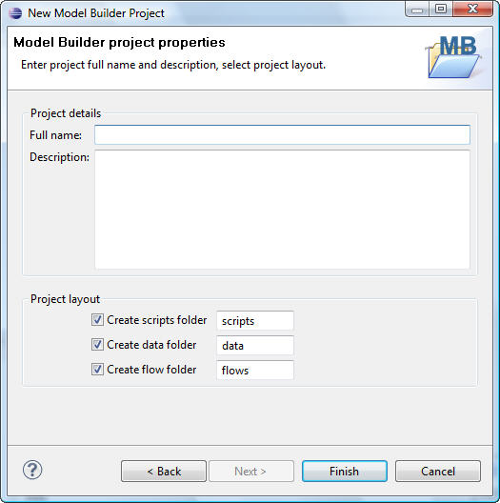
Create a New Model Builder 7 Project
More options when creating a new project
Add detailed description of the new project
Specify optional sub folders in the new project
scripts: contains script files (source code)
data: contains dataset files
flows: contains analytic flows
Use default or custom names

Slide 34
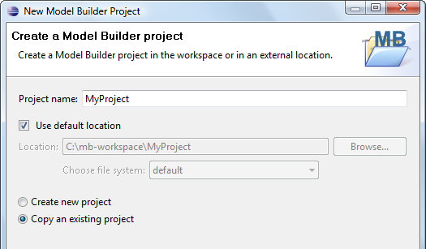
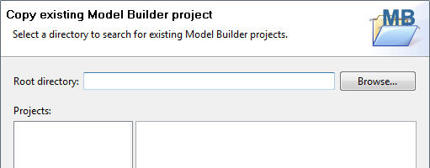
Copy an Existing Model Builder 7 Project
When creating a new project, user has the option to copy an existing project

Slide 35
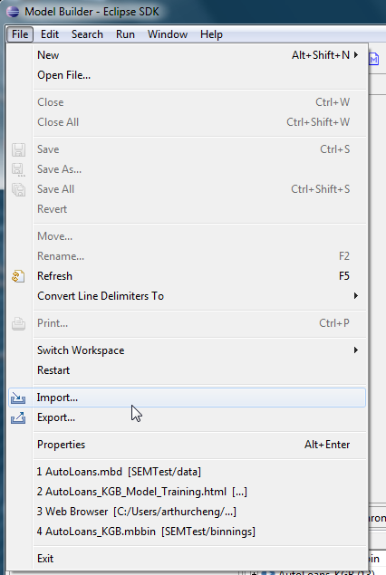
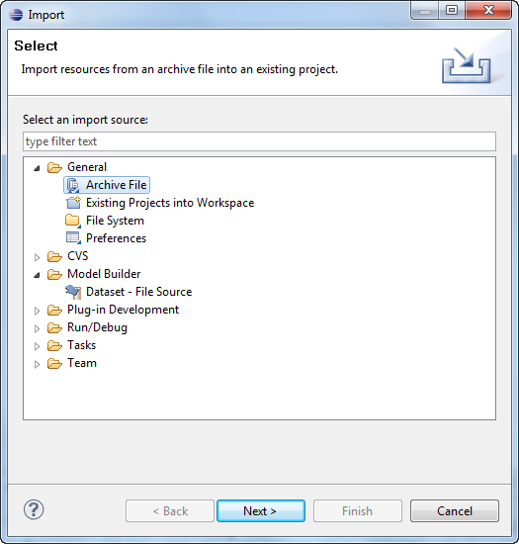
Import/Export an Existing Model Builder 7 Project
User can also import/export a project from/to a zip file or project folder

Slide 36
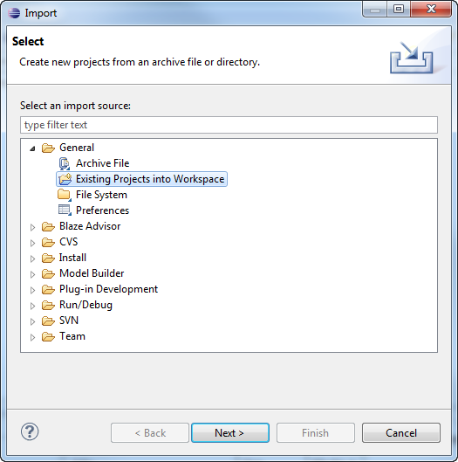
What if a project is missing?
User may delete unused projects from the Project Explorer
With the option to keep or also remove project contents on disk
To bring a deleted (missing) project back, use File -> Import -> Existing Projects into Workspace

Slide 37
Section 2 Data Import and Analysis
Product Education
FICO

Slide 38
Section 2 Data Import and Analysis
At the end of this section, you will have learned to:
Describe the Model Builder 7 supported data file formats
Import data
Handle missing values
Use data browser to view data
Use filter in data browser
Describe and use data analysis tools
Use variable binning in data analysis

Slide 39
Supported Data File Formats
Model Builder 7 supported data file formats
Text files
*.csv, *.txt, *.csv.gz, *.tab
SAS data files
*.sas7bdat
*.xpt, *.tpt, *.stx
*.sd1, *.ssd01, *ssd04
Database tables (through custom scripting)
Model Builder 2.x and 3.6.x native files
*.mbn
Model Builder 7 native files
*.mbd

Slide 40
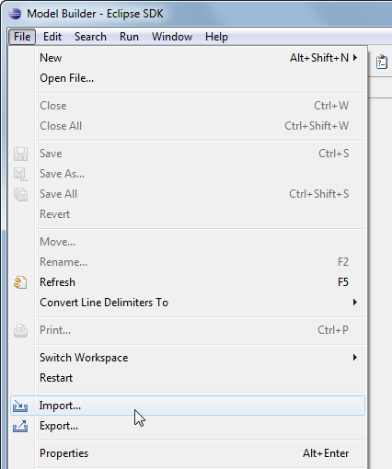
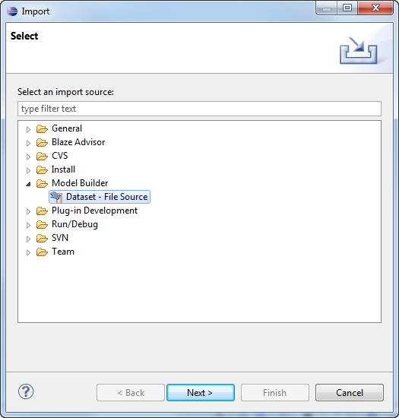
Data Import Wizard
Use Data Import Wizard to import data files

Slide 41
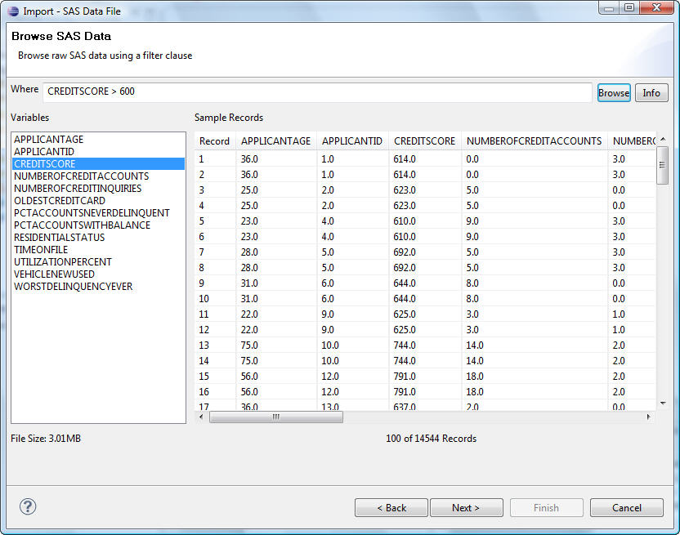
Specify Data Import Parameters – SAS Data
In Data Import wizard, we can specify parameters to control how the data is going to be imported
Data filter: use a filter query to view the records that satisfy the filter criteria (available only for SAS data files)

Slide 42
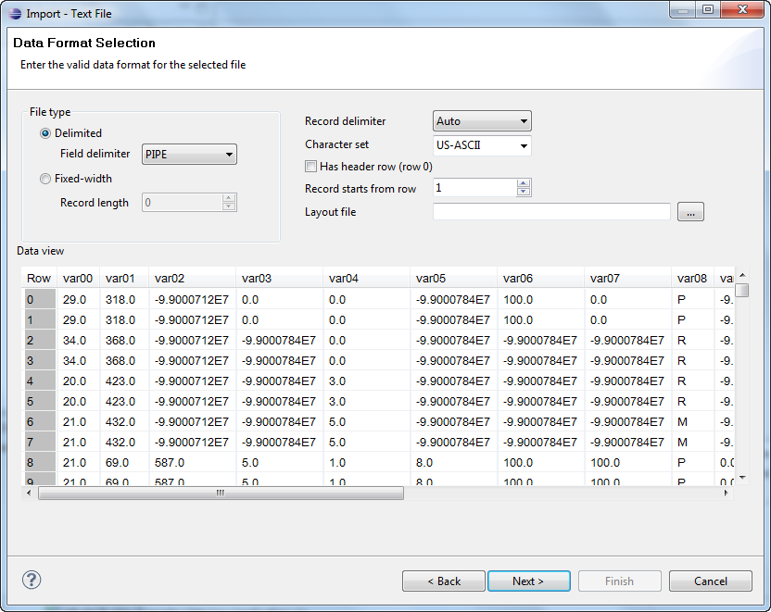
Specify Data Import Parameters – Text Data
Parameters when importing a text data file (txt, csv, etc.),

Slide 43
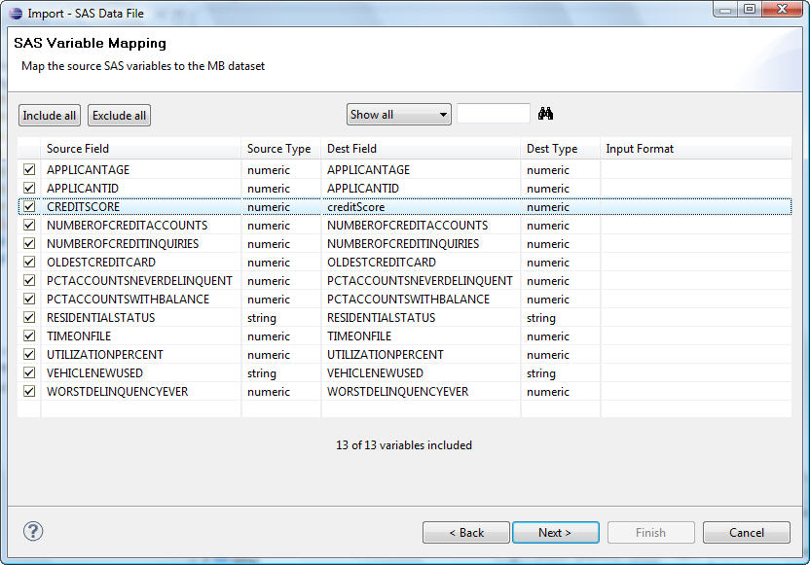
Specify Data Import Parameters – SAS Data
Specify variable mapping, including variable names and types

Slide 44
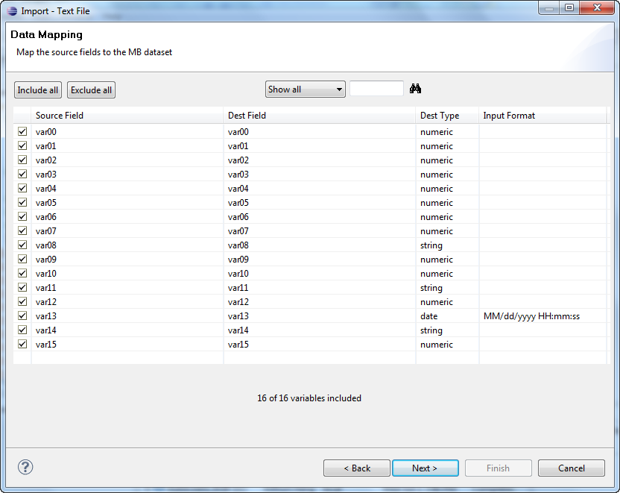
Specify Data Import Parameters – Text Data
Data mapping parameters when importing a text data file

Slide 45
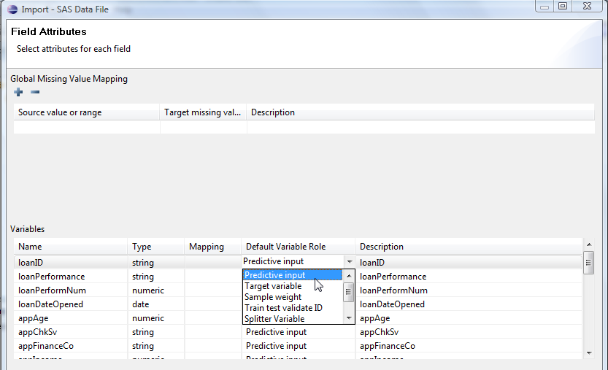
Specify Data Import Parameters
Specify field attributes, including variable roles
Predictive input
Target
Sample weight
Train / test validate ID
Splitter variable
Record ID
Uninformative

Slide 46
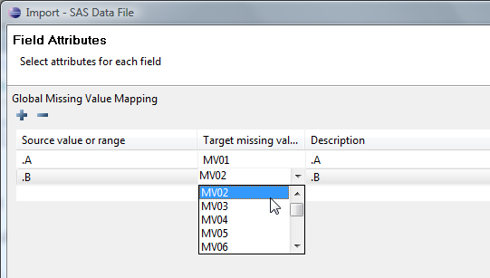
Handling Missing Values
When importing a dataset, user can specify missing value mapping for each variable
Missing value mappings can be either global or variable-specific
Global Missing Value Mapping

Slide 47
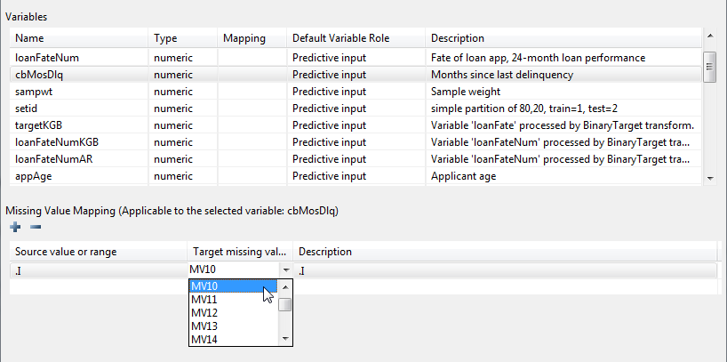
Variable-Specific Missing Value Mapping
Click on one of the variables, then add variable-specific Missing Value Mapping

Slide 48
Handling Missing Values
Missing values are sometimes called special values or special missing values
They are values defined by Model Builder when their values from original data source are unavailable or could not be determined
Values could be missing for various reasons. It is useful to think of a missing value as one of many, or as only a default missing value.
Missing values of string data are represented as empty strings
Missing values of date data are represented as null.
The numeric data type has 101 labeled missing values.
The missing values print with the labels MV, MV00, MV01,…, MV99
The missing values do not equal any non-missing values
The missing values can be sorted
When used as doubles, simple arithmetic operations involving missing values will return a missing value.

Slide 49
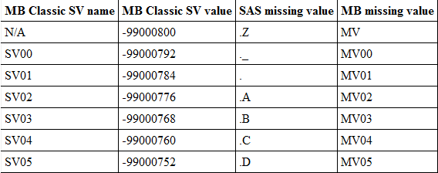
Missing Value Mapping
Default mapping between Model Builder Classic, SAS, and Model Builder 7 missing values

Slide 50
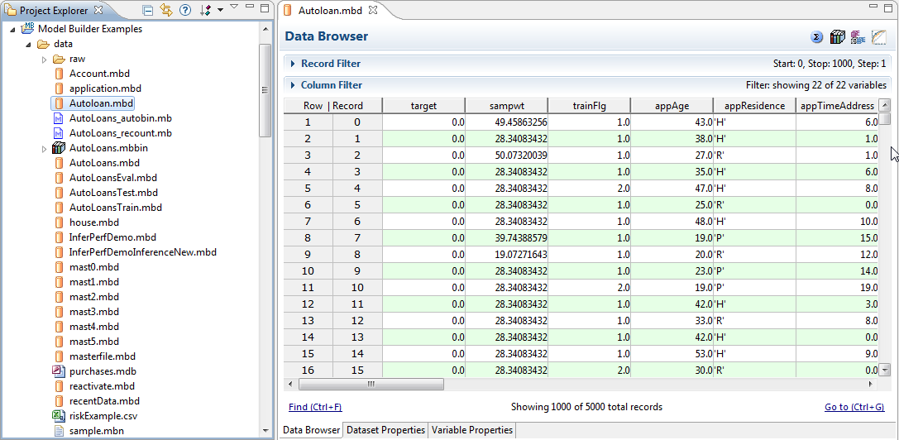
Examine Data Import Results
New items generated
A Model Builder 7 native data file (*.mbd file)
Double click on the .mbd file to open the Data Browser

Slide 51
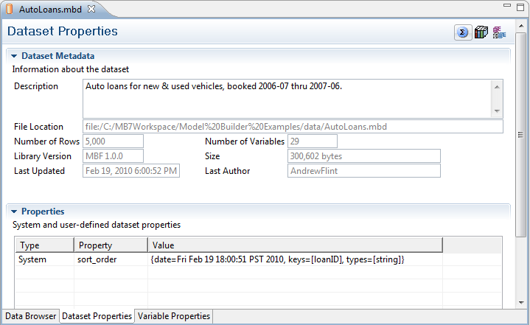
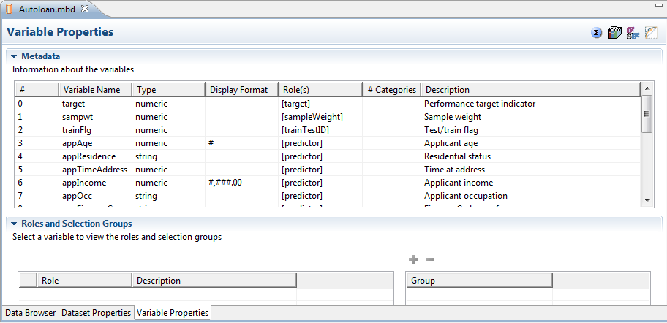
Using the Data Browser

Slide 52
Data Analysis Tools
Univariate statistics
Provides a summary table containing various descriptive statistics on selected variables.
E.g., mean, max, median, variance, standard deviation, etc.
Frequency distributions
Provides a numerical summary of data distribution
E.g., count, percentage, cumulative values
Quantiles
Points taken at specified intervals from the cumulative distribution function of a variable
Covariances
Measures the extent to which one variable changes according to the change of another variable, aka, correlation

Slide 53
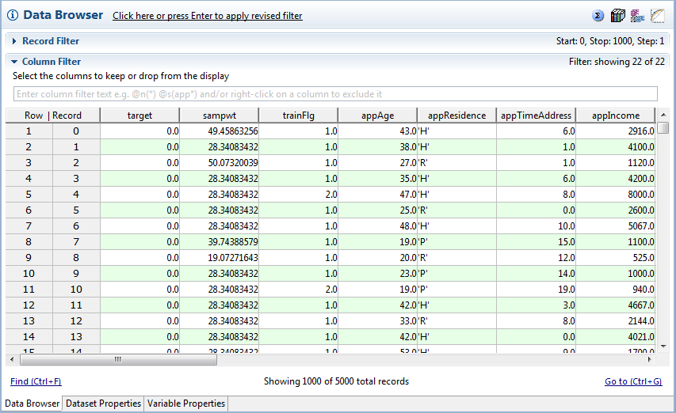
Statistics Editor
Model Builder 7 has a Statistics Editor where user can define statistics calculation configurations
The Statistics Editor can be directly accessed from Data Browser

Slide 54
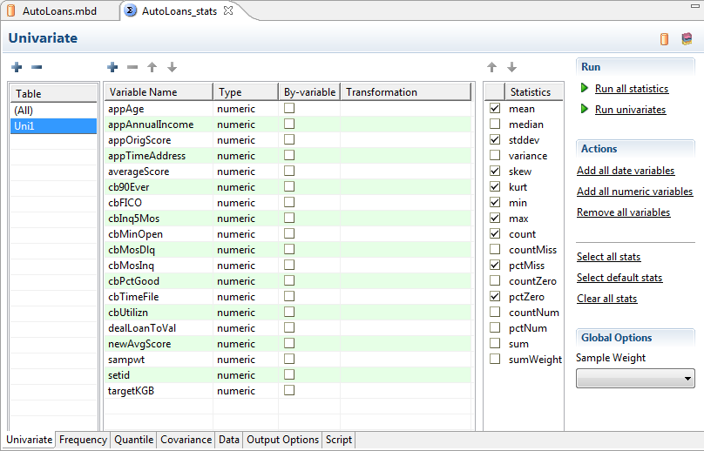
Statistics Editor
Variable list
Table list
Actions
Available statistics
Configuration tabs

Slide 55
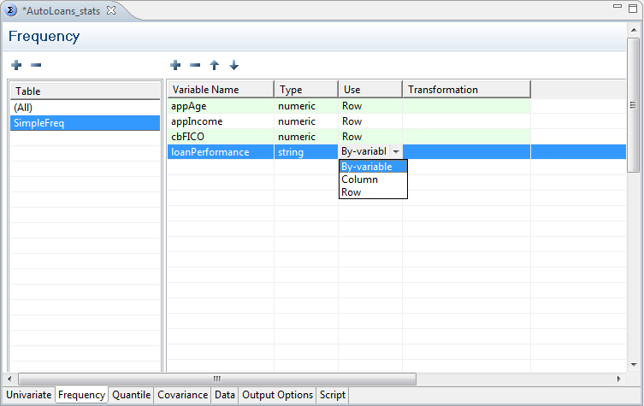

Statistics Editor
Frequency configurations
Quantile configurations

Slide 56

Generate Statistics Reports
After completing statistics configuration, user can click “Run all reports” and “Run frequency reports” links to generate statistics reports
Model Builder executes a script behind the
scene to calculate all statistics based on
the configurations defined in the
Statistics Editor

Slide 57

Generate Statistics Reports
By default, all reports are generated in the same folder of the statistics script. This can be changed by configuring Output Options

Slide 58

Generate Statistics Report
Viewing generated statistics report
Since Model Builder 7.1, by default all reports are consolidated into one single file

Slide 59

Variable Binning
In the Frequency report, some variables may have too many rows…
How to make the freq table more descriptive?

Slide 60
Variable Binning
Binning is the process of grouping or discretizing a variable into subgroups called bins. In many cases it is advantageous to view a variable with a finite number of discrete values (binned values) rather than the raw values.
Viewing the distribution of a numeric variable is a typical place where binning is useful. Having a finite set of bins help to produce a more meaningful frequency computation over a continuous type numeric variable.
Binning is extensively used in modeling where numeric data is used. String and date variables can also be transformed through a binning into simple numeric values.
Binning is required for building scorecard models in Model Builder.

Slide 61
Variable Binning
Setting up a binning configuration manually:
- means negative infinity
+ means positive infinity
*m means missing
Parentheses denote open intervals
Brackets denote closed intervals
Examples
(0, 4] means 0 < x ≤ 4
(-,0) means -∞ < x < 0
[0,+) means 0 ≤ x < ∞
*m means placing all the missing values in this bin

Slide 62
Binning Library
A Binning Library is a collection of variable binnings
For each variable binning, the Binning Library contains its
Label names
Bin specification
Number of bins
Number of low and high target values
WOE (Weight of Evidence)
IV (Information Value)
Odds of each bin

Slide 63
Binning Library
A Binning Library is a project item (file) in a project folder.
Binning libraries can be created
directly from a native dataset

Slide 64

Binning Library
A binning library (*.mbbin file) can be shared by different models
A binning library can be viewed and edited in the Binning Library Editor

Slide 65

Edit Variable Binning
Select a variable, then click on the “Edit selected binning(s)…” link to edit variable binning

Slide 66
Section 3 Introduction to Model Builder Scripting
Product Education
FICO

Slide 67
Section 3 Introduction to Model Builder Scripting
Topics
Introduction to scripting in Model Builder 7
How to customize automatically generated script
How to use script templates

Slide 68
Introduction to Scripting
Groovy is the scripting language used in Model Builder 7 to perform all kinds of jobs
Data import and analysis
Data manipulation
Sorting, merging, collating, variable generation
Variable binning
Model training
Model deployment
Groovy is an agile and dynamic programming language for the Java Virtual Machine
Groovy builds upon the strengths of Java, but has a lot of additional powerful features
The Eclipse platform shipped with Model Builder 7 has Groovy compiler built-in

Slide 69


Introduction to Scripting
Model Builder 7 provides both automatic and manual scripting functionalities.
All activities we have introduced so far can be implemented either by automatic scripting or manual scripting
Example of automatic scripting

Slide 70



Create a Script File

Slide 71

Automatically Generated Scripts
Model Builder automatically generates scripts for a number of analytic activities, including
Data import
Statistical analysis of datasets
Variable binning
Model training
Performance inference
Analytic flow execution
Model performance
Segmentation search
Segmentation model training
And many others

Slide 72

Customizing Automatically Generated Scripts
Very often user may want to customize automatically generated scripts instead of writing new scripts from scratch
Automatically generated scripts are by default read-only, and can be modified only in the Script Editor
Read-only code

Slide 73
Model Builder Example Project
Model Builder Example Project has many example scripts that cover various functionalities of Model Builder
Users new to Model Builder scripting are encouraged to review the examples to quickly get familiar with the programming syntax and style

Slide 74
Section 4 Modeling Techniques in Model Builder 7
Product Education
FICO

Slide 75
Section 4 Modeling Techniques in Model Builder 7
Topics
Linear regression
Logistic regression
Neural network

Slide 76
Modeling Techniques in Model Builder 7
Model Builder 7 supports following modeling techniques
Linear Regression
Logistic Regression
Neural Networks
Scorecard
Divergence
Bernoulli likelihood
Least squares
Multi-goal
Ranged divergence
The choice of modeling technique depends on
Business requirement and objective
Data
Target

Slide 77


Create a Model

Slide 78


Create a Model
First choose the type of target, then choose available modeling techniques
Choose the dataset used for modeling

Slide 79

Binary Target
Binary target predicts one of two mutually exclusive outcomes.
Default vs. pay, attrite vs. renew, respond vs. ignore, fraud vs. legitimate
Modeling techniques available for binary target
Scorecard – Divergence
Scorecard – Bernoulli Likelihood
Scorecard – Range Divergence
Segmented Ensemble
Neural Network
Logistic Regression
Decision Tree

Slide 80

Continuous Target
Continuous target estimates a continuously varying value
Balance, net revenue, loss-to-premium ratio, credit conversion factor, monthly spending
Modeling techniques available for continuous target
Scorecard – Least Squares
Linear Regression
Decision Tree

Slide 81

Multiple-Goal Target
Multiple-Goal target predicts a primary binary outcome while optimizing a secondary outcome
Attract responders while preferring lower-risk responders, detect all fraud but especially on high-value transactions
Modeling techniques available for multiple-goal target
Scorecard – Multiple Goal

Slide 82

Multinomial Target
Multinomial target predicts one of two or more discrete outcomes
Examples: Account Status (Active/Inactive/Closed by user/Closed by bank)
Modeling technique available for multinomial target
Decision Tree

Slide 83

Model Example
Creating a linear regression model

Slide 84

Model Example
Choose primary target, sample weight variable (optional), and champion score variable (optional)

Slide 85

Model Example
Choose model validation type
Using Train/Test Variable (set ID)
Bootstrap validation (for small datasets)

Slide 86

Model Example
Select location of new model script

Slide 87

Model Example
Review model summary and choose to automatically run model training and generate model performance report

Slide 88

Linear Regression Example
Necessary script files will be automatically generated, and if directed, Model Builder will execute the scripts in order and generate results and reports

Slide 89



Linear Regression Example
When creating a linear regression model from the model wizard, by default the model uses all predictor variables
If desired, user can specify a variable selection scheme in the generated model script
Available variable selection routines:
Forward
Backward
Stepwise
$R^{2}$-max
Adjusted $R^{2}$-max

Slide 90

Logistic Regression Example
Binary target – may require target variable transformation if target variable is not already binary with 0 and 1

Slide 91
Section 5 Introduction to Scoring
Product Education
FICO

Slide 92
Section 5.1 Concepts of Scoring
Scoring concepts
Terminologies in Scoring
Advantages of Scoring

Slide 93
What is Scoring?
Scoring is a predicative modeling technique that assigns a score to each subject to predict either the likelihood / probability of a certain prospect or a continuous target
Likelihood of default
Likelihood of fraud
Likelihood of responding to offer
Likelihood of attrition
Loss ratio
Exposure at default
Severity
Scoring is widely used together with business rules, and is instrumental in determining and deploying the best business rules
In Model Builder 7, user can build scorecard models to do scoring

Slide 94
Scoring Concepts
Variable
Information obtained from data sources representing a certain perspective of subjects
E.g., Age, Time at address, Time at employer, Residential status, No. of inquiries
Characteristics are binned variables
Binning is the analytic activity to partition the value range of a predictive variable into mutually exclusive and collectively exhaustive sets, aka, “bins”
For example, the bins of variable Age may be
< 20
20~25
25~30
…
60~65
> 65
An attribute is the value of a variable on a given individual record

Slide 95
Review of Scoring Concepts
Explain the following concepts in scoring
Variable
Characteristic
Attribute
Binning
Bin
Score formula
Fitting a scorecard
Score weight
Score

Slide 96
Scores can Rank-order Risk
240
220
200
180

Slide 97
An Example of a Typical Application Scorecard
Notes:
Here is an example of a typical application scorecard. This example scorecard includes the credit bureau score as a variable. An application scorecard may or may not include the credit bureau score, depending on the lender’s preference.

Slide 98
An Example of a Typical Application Scorecard
Number of Credit Bureau Inquiries
Variable
0
1
2 or more
No Information
50
40
35
42
Score Weight (Scaled)
Score = sum (Score Weights)
Attribute / Bin
Bank Card Utilization
Below 20%
20% < 80%
80% or more
No Information
50
40
30
39
Highly Interpretable
Efficiently computed
Engineered for palatability and compliance
Scaled to simplify use of segmented models
Number of Satisfactory Credit Bureau Ratings
0-3
4-7
8-9
10 or more
No Information
15
20
25
35
26

Slide 99
Section 6 Creating a Scorecard Model
Product Education
FICO

Slide 100
Section 6 Creating a Scorecard Model
Topics
Using Scorecard Wizard
Setting Auto Binning Parameters

Slide 101


Create a New Scorecard Model
Create a new Scorecard model through the New Model wizard.
From tool bar
From menu

Slide 102

Create a New Scorecard Model
User can also conveniently open the New Model wizard from Data Browser

Slide 103

Create a New Scorecard Model
Choose modeling dataset, target type and fitting objective function

Slide 104

Create a New Scorecard Model
Choose Scorecard parameters
Target variable
If the selected target variable is not binary, user has to transform it into a binary variable
After transformation, a new target variable is automatically created. User can assign its name, and labels for high and low score groups

Slide 105

Target Variable Transformation
When transforming the target variable, user needs to assign the High and Low score groups
The High score group tends to have higher scores
The Low score group tends to have lower scores
E.g., high FICO scores means lower risk, low FICO scores means higher risk
For the newly created transformed target variable, the High score group has value 1, and the Low score group has value 0. The Other group has value 2.

Slide 106

Sample Weight and Champion Score Variables
Optionally, user can select a Sample Weight Variable and a Champion Score Variable
If a Champion Score Variable is selected, Model Builder will generate reports (e.g., ROC curves) that compare the output scores of the new scorecard model and the Champion Score Variable

Slide 107

Validation Type
Select validation type
For large dataset, Train/Test Variable (set ID)
1 means training data
2 means validation/test data
User can either use an existing Set ID variable, or create a new one and specify the percentages of 1 and 2 data records
For small dataset, use Bootstrap validation

Slide 108

Binning Library
User can either use an existing binning library or let Model Builder create a new binning library and bin selected variables
If creating a new binning library, user needs to specify its location and name

Slide 109

Auto-Binning Variables Selection
Select the variables that are going to be auto-binned

Slide 110


Auto-Binning Variables Selection
User may want to specify the Rounding type of the variables

Slide 111
Choose Appropriate Rounding Types
If using default rounding type, it may yield ugly bin breaks
Bin # | Description
1 | 'Below 549'
2 | '549 -< 587'
3 | '587 -< 613'
4 | '613 -< 633'
5 | '633 -< 649'
6 | '649 -< 666'
7 | '666 -< 686'
8 | '686 -< 714'
9 | '714 -< 752'
10 | '752 - High'
Better use an appropriate rounding type to control bin breaks Multiples of 10 for a scaled score variable
Multiples of 5 for a percentage variable
Quarterly, semi-annually, and annual breaks for a “month” variable
e.g. bins of FICO score variable

Slide 112

Model Output Options
The New Scorecard Wizard will create a new script file. User needs to specify the name and location of the script file

Slide 113

Review New Model Specifications
At last, review the specifications of the new model
User has the option to run Model Training immediately and generate Model Performance Report

Slide 114


Review Model Training Output
Scripts, logs, and reports are generated in respective folders

Slide 115
Section 7 Variable Binning – Fine Binning
Product Education
FICO

Slide 116
Section 7 Variable Binning – Fine Binning
Topics
Binning Concepts
Binning Library and Scorecard
Auto-Fine Binning

Slide 117
Why Binning?
Binning is the analytic activity to partition the value ranges of a predictive variable into mutually exclusive and collectively exhaustive sets, aka, bins
All variables must be binned before they can be used to build a scorecard model. Binned variables are called characteristics
In statistics, binning is equivalent to creating dummy/indicator variables
Benefits of binning
Captures non-linear relationship between target and predictive variables
Provides a way to reign outliers in, yet still capture the information contributed by them
Makes models more interpretable
Allows user to apply experience and domain expertise

Slide 118
Example of Binning
Each bin receives a score weight when training a scorecard model.
Variable Score
True regression function
Variable Score: a step
function approximation
#1 #2 #3 #4 … Age bins

Slide 119
Binning Process in Scorecard Development
The binning process in scorecard development includes
Fine binning
Coarse binning
Fine
Binning
Coarse
Binning
Coarse
Binning
x
c
SM
Prediction
variable
Binned
variable
Frequency f(x)
Fine bins
Coarse bins
x

Slide 120
Fine Binning and Coarse Binning
Fine binning is the first step, which normally creates a large number of narrow (conservative) bins
Coarse binning is the process of combining adjacent fine bins into a smaller number of wider bins
Coarse bins are used in scorecard training, NOT fine bins
Coarse bins are based on fine bins, and they are reversible
Changing coarse bins will not affect underlying fine bins
Changing fine bins WILL invalidate coarse bins

Slide 121
Fine Binning
Fine binning tends to capture patterns and noises in the data
Time with Employer
RELATIVE RISK
High Risk Low Risk
Low
HIgh

Slide 122
Coarse Binning
Coarse binning tends to preserve pattern and reduce noise, and in turn minimize overfit to the data
Time with Employer
RELATIVE RISK
High Risk Low Risk
Low
High

Slide 123

Binning Library and Scorecard
Each scorecard model is associated with a Binning Library
When creating a new scorecard model through the New Model wizard, user can choose to create a new binning library or use an existing one
The binning library of a scorecard model can be opened from Scorecard Model Editor

Slide 124

Binning Library and Dataset
Binning library allows user to easily change backing dataset

Slide 125

Binning Library
Binning library contains variable binnings for training scorecard models
A variable can have multiple binnings if it has been cloned
Changes to bins made directly in the binning library take effect on scorecards immediately
Fine bins and coarse bins can be edited manually in the binning library

Slide 126

Editing Bins
User can edit bins by using
Group and Ungroup buttons (at coarse bin level only)
Move Up and Move Down buttons
Move to existing coarse bin and Move to a new coarse bin buttons (at fine bin level only)

Slide 127




Fine Bin Power Editing
Binning editor allows user to quickly create palatable fine bins using desired parameters
Boundaries
Start, stop and step size

Slide 128


View Bins
User can choose to view coarse bins only, fine bins only, or both

Slide 129

Auto-Binning
User can perform auto-binning on all variables in a binning library
Auto-binning algorithms
Fine Unsupervised
creates fine bins without regard to a target
Fine Supervised
creates fine bins taking into consideration target counts in each bin
Fine Coarse Supervised
creates fine bins and coarse bins based on target counts in each bin
Coarse Supervised
creates coarse bins from existing fine bins
Recount
counts number of observations in each fine bin
After choosing a binning algorithm, user
can run auto-binning on selected or all variables

Slide 130

Auto Binning Parameters
User can set appropriate parameters for auto-binning

Slide 131


Auto Binning Parameters
If using supervised binning, user needs to specify the primary target
Optionally, specify the sample weight variable
Specify whether to use sample-weighted counts
Specify parameters for both string and numeric variables

Slide 132
Auto Binning Parameters
Max Fine Bins
The maximum number of fine bins of a string variable
Example: Before auto-binning an Occupation variable, it may look something like this….
x = Profession | Counts
Sales | 223
Manager | 191
.. | ..
Professor | 4
Clown | 2
King | 1
Dataset may contain
300s unique professions

Slide 133

Auto Binning Parameters
After auto binning the Occupation variable, it may look like this
Bin # | Description
1 | Sales
2 | Manager
.. | ..
49 | Professor
50 | All Other
49 bins for the most
frequent professions
“All Other” bin lumps
the rest together

Slide 134
Auto Binning Parameters
For numeric variables, user can specify
Desired % of total in fine bin (default 5%)
By default, no fine bin contains less than 5% of the total population
Desired % of Fine Target Set in fine bin (default 2%)
User defines Fine Target Set {Good} and {Bad}
By default, no fine bin contains less than 2% of the Goods or the Bads
Minimum number of unique values (default 2)
Above is the ideal situation. We usually see bins with slightly more than the desired percent specified

Slide 135
Section 8 Variable Binning – Coarse Binning
Product Education
FICO

Slide 136
Section 8 Variable Binning – Coarse Binning
Topics
Coarse Binning Concepts
Auto-Coarse Binning Algorithms

Slide 137
Coarse Binning Concepts
Fine binning tends to be conservative and “general purpose” - preserves most of the predictive information in the data
Coarse binning is more focused - controls for the predictive information about a specific target
Fine binning
(with counts)
Coarse binning
specifications A
Coarse binning
specifications B
Coarse binning A suitable
for “Known” model
Coarse binning B suitable
for “TTD” model

Slide 138
Coarse Binning Concepts
Coarse Binning is “reversible”
When fine bins are modified, recount is required
User can ungroup coarse bins and re-group them in different ways, without recounting
Fine bin j | Coarse bin k
1 | 1
2 | 1
3 | 1
4 | 2
5 | 2
… | …
27 | 11

Slide 139
Coarse Binning Concepts
Purpose of coarse binning
Ensure sufficient counts within each attribute bin to support reliable statistical analysis
Ensure the risk patterns represented by the data are palatable in a business environment
Ensure a robust scoring model which is resistant to outlier effects
The measure of effectiveness on which the analyst must focus is the Weight of Evidence or WoE for short

Slide 140
Weight of Evidence (WoE)
Weight of Evidence (WoE)
measures performance of a bin relative to average
Positive WOE indicates better than average
Negative WOE indicates worse than average

Slide 141
General Guidelines of Coarse Binning
Bin so that WoE has a smooth and palatable pattern
If non-linear pattern is seen in data and this relationship is explainable then apply non-linear binning
Have enough counts in both the high and low score groups
How many is “enough”? As a general rule of thumb,
1200 raw observations in each principal group
At least 50 raw counts or 5% of the factored percentage in each principal set of each bin
Divide the data as evenly as possible between attributes. This is especially important for continuous variables.
For attributes with small counts and you are unsure how to bin them, make them “No Information” by assigning 0 weight
Keep missing values as separate bins from “No Information”

Slide 142
General Guidelines of Coarse Binning
For large sample (e.g., broad based redevelopment projects), bin the “tails” of the data more finely
If there are smooth patterns in the tails, keep the fine binning
If there are large jumps, re-bin more coarsely
Pay attention to special values within continuous variables
It is recommended to use the “Raw Counts” to ensure a sufficient number of counts within each attribute bin

Slide 143
Impact of Coarse Binning
Information Value (IV)
measures the predictive strength of a binned variable
sum over IV Contributions from the m bins of a variable

Slide 144
Impact of Coarse Binning
Coarse Binning may cause IV loss
Old Binning | fG | fB | WoE | fG-fB | IV Contrib
1 | 0.4 | 0.3 | 0.29 | 0.1 | 0.029
2 | 0.3 | 0.2 | 0.41 | 0.1 | 0.041
3 | 0.3 | 0.5 | -0.51 | -0.2 | 0.102
 |  |  |  | IV old: | 0.172
New Binning
{1,2} | 0.7 | 0.5 | 0.34 | 0.2 | 0.067
3 | 0.3 | 0.5 | -0.51 | -0.2 | 0.102
 |  |  |  | IV new: | 0.169

Slide 145

Auto-Coarse Binning Algorithms
User can run auto-coarse binning from a binning library
Auto-coarse binning algorithms can do coarse binning in three ways
By Count
By Similarity
By Pattern
User can choose to use one or several of these methods
Auto-coarse binning always starts from Count stage

Slide 146
Section 9 Building Scorecard
Product Education
FICO

Slide 147
Section 9 Building Scorecard
Topics
Conceptual Approach to Scorecard Development
Variable Selection
Auto variable selection
Manual variable selection
Model Version History

Slide 148
Conceptual Approach to Score Development
Divide data into Training and Test samples
Specify a family of score formulas, { S(D) }
Specify a fitting objective function (FOF)
Let a fitting algorithm optimize FOF on training sample
May use automated variable selection
Evaluate merits of fitted model based on a value of Business Objective Function (BOF), typically on the test sample
Modify modeling specifications and retrain the model until palatable and high BOF value is obtained

Slide 149
Variable Selection
Analyst has generated dozens, maybe 100’s of candidate variables
All qualify for inclusion in scorecard
How does the analyst choose which variables to use?
Basic approach
Select the subset of variables that maximize the fitting objective function
Select the variables that are
Easy to obtain to ensure efficiency in process
Easy to calculate and score
With palatable decline reason for customer service
Stable over time
Legally safe to use

Slide 150
Variable Selection
Practical considerations
Desirability
Some variables may be undesirable for business reasons
Different variable selection thresholds can be set for each variable
Diversity
The scorecard will reason more robustly if it depends proportionally on a diverse group of variables that cover different concepts
Demographic information
Credit / Account history
Delinquency information
Inquires
Credit bureau variables
Variable selection can pick the best variable that describes each concept as defined by the user

Slide 151
Iterative Scorecard Building
Train
the
scorecard
Evaluate model
weights
Add / Remove
Variables
Modify Binnings
Evaluate variables
Marginal Contribution
Are there candidates for inclusion?
Are there candidates for removal?

Slide 152
Automated and Interactive Variable Selection
User can select variables for scorecard models either interactively or by running automated variable selection procedures provided by Model Builder
As a normal practice
At the beginning user can run automated variable selection and examine the variables suggested by Model Builder
After that, user can decide if he/she wants to manually add or remove some variables based on his/her experience and domain expertise

Slide 153
Automated Variable Selection
Automated variable selection can quickly identify a predictive and palatable subset of candidate variables for building scorecard models
Resulting scorecard is a suggestion or starting point - to be scrutinized and refined by the analyst
Automated variable selection algorithm evaluates the Marginal Contribution of candidates to determine whether to drop or keep them

Slide 154
Marginal Contribution (M.C.)
For variables already in the model, M.C. is:
Reduction in the FOF value when dropping a variable from the model
For variables NOT already in the model, M.C. is:
Increase in the FOF value when the a variable is added to the model
The calculation of marginal contribution, is proprietary at FICO, but based on the difference between the expected proportions of good and bad accounts in an attribute group, as determined by the current/existing model score (at that point in the development), and the actual proportion of goods and bad account observed in the attribute. This is calculated for each attribute band for each candidate model variable

Slide 155
Marginal Contribution (M.C.)
Differences which exist between these actual and expected values indicate that further adjustments to model score weights are required to bring the expected values in line with the actual values. If variables exist which can be introduced into the model to bring a reduction in this differential, then model predictive power also increases
Correlation that exists between variables means that the MC values must be recalculated once a variable enters the model. In this way, the MC statistics can continue to be used to reaffirm the effectiveness of a variable once inside the model, as well as help the model developer decide upon the candidate variables for model entry
Manual expertise is typically required to ensure that models are not biased to one type of variable. Therefore MC should not be used as the only factor in variable selection

Slide 156
Automated Variable Selection
Automated Variable Selection is an iterative process
At each iteration of the algorithm, two sets of variables:
Variables that are currently in the model
Variables that are candidates for inclusion in the model (currently outside the model)
Variables can be promoted and demoted between these sets
In-model
Demotion
V1, V2, V4,
V5, V7, …
Out-of-model
Candidates
V3, V6,
V8, …
Promotion

Slide 157

Automated Variable Selection
For each iteration of the algorithm
Demote a set of in-model variables based on their Marginal Contributions
Promote a set of out-of-model variables based on their Marginal Contributions
Continue until there are no more demotions and promotions
User can define the maximum number of iterations (Maximum Steps)

Slide 158

Automated Variable Selection Parameters
User can specify automated variable selection parameters to control the otherwise fully-automatic selection process

Slide 159
Global Parameter for Demotion
Stay in Model Threshold
During a certain iteration, in-model variables must have M.C. higher than the threshold to stay in the model
The predictive power of a variable can change from one iteration to another
A variable that was strongly predictive in iteration 2 might fall below the threshold and be demoted in iteration 4.
If the predictive power of an in-model variable falls below the threshold, it’s demoted out of the model back to the set of candidate variables.

Slide 160
How are the Thresholds Set?
Thresholds affect performance on the hold-out sample
Experience provides guidelines
Default M.C. thresholds are 0.03
Appropriate threshold values will vary between projects
Analyst should perform sensitivity analysis - how threshold values may affect results

Slide 161

Scorecard Model Editor
Model Builder provides a front-end for user to configure scorecard models

Slide 162

Scorecard Model Editor
Display of selected variables
Column Initial denotes user-selected variables
Column In denotes automatically selected variables

Slide 163
Scorecard Version History
Model Builder keeps track of the version history of a scorecard model
User can easily navigate among different versions of a model and switch between them
Model Builder also provides a version history diagram, in which user can
Open a selected version (in the same or a new editor)
Edit note on a selected version
Make a selected version the working version

Slide 164

Scorecard Version History

Slide 165

Scorecard Version History
Version 2 as the new working version

Slide 166


Scorecard Reporting
When training a scorecard, user can choose to generate model training, fitting, and performance evaluation reports
Report configuration can be set in the Reports tab of Scorecard Model Editor

Slide 167

Scorecard Reporting
Scorecard training report – Model Variable List

Slide 168

Scorecard Reporting
Scorecard training report – Model Detail Report

Slide 169

Scorecard Reporting
Scorecard training report – Summary Score Statistics

Slide 170

Scorecard Reporting
Model Performance Report – Summary Score Statistics of model score and champion score (if applicable) on both training and testing datasets (if applicable)

Slide 171

Scorecard Reporting
Model Performance Report – ROC Curve

Slide 172

Scorecard Reporting
Model Performance Report – Score Distribution

Slide 173


Model Performance
User can create a Model Performance configuration to persist performance reporting settings, as well as compare performances of different score variables and models

Slide 174

Model Performance
In Model Performance editor, user can add score variables and models

Slide 175

Model Performance Report
Model Performance report shows summary score statistics, ROC curves, as well as score distribution tables

Slide 176
Lab Building Scorecard
In this lab, you are going to
Practice using AutoLoans Dataset
Manually select variable for a scorecard model
Build a scorecard model

